Slide 1
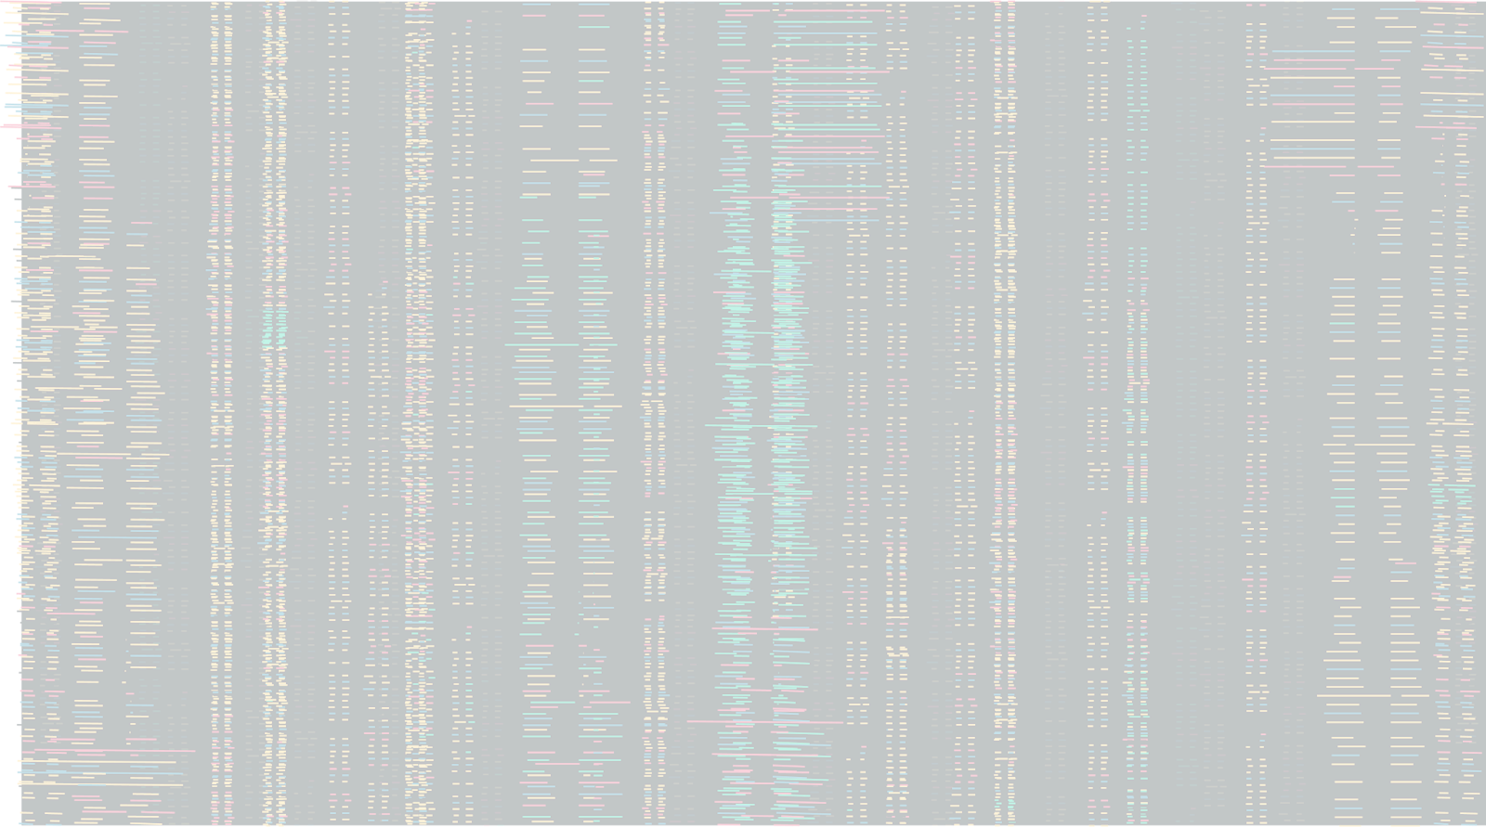



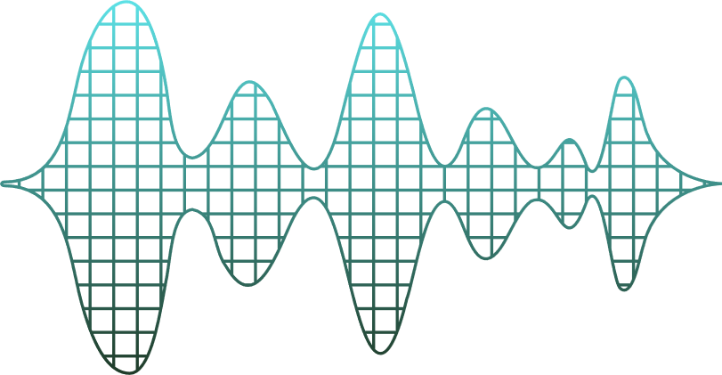
Protecting Pandas Project
CYBR-504 Final Group Presentation
Group 3
PRESENTATION
Jacob Napierskie - Kayvon Karimi - RC Wright - Michael Yap

Slide 2






TIF Works
01.
INTRODUCTION
The World Panda Protection League (WPPL) is facing growing threats from poachers
Pandas are being tracked and harmed in the Jìnlìe Xióngmāo Bǎohùqū Forest Preserve.
WPPL uses RFID collars and environmental sensors to monitor pandas.
Despite efforts, poachers are still getting through. WPPL suspects:
Intercept tracking signals
Manipulate sensor data
Exploit insider leakes to bypass security measures

Slide 3

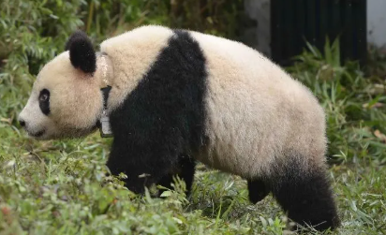

TIF Works
Details of the Current Situation
Tracking System Overview
WPPL uses RFID tags + 4,000 Zigbee-style sensors to track pandas.
Sensors detect tags within short range, sending 32-byte messages to a central server.
Rangers use a mesh network and limited on-site tools to monitor movement.
Ongoing Issues
Pandas still go missing or are found harmed, despite safeguards.
Two past consulting teams failed to stop the breaches.
Critical vulnerabilities remain unresolved.
Evidence from the Field
Poachers found with radios, computers, cryptography books, and encrypted drives.
No signs of physical sensor tampering or station hacking.

Slide 4

TIF Works
Details of the Current Situation
Ranger Station Weaknesses
25 staff members, high part-time turnover
Data stored on a local server (Kylin OS) with basic username/password
No encryption on sensor data; no multi factor authentication
Sensor + Tag Limitations
Passive RFID tags, detected only at short range.
Messages unencrypted: timestamp, IDs, conditions.
Sensors can’t be remotely reprogrammed.
Constraints
Sensor hardware can’t be modified — only add-on modules allowed.
Must ensure backward compatibility. Budget: $100K preferred, $267K max.

Slide 5

TIF Works
Identifying the Problem
RFID Signal Vulnerabilities
Tags operate on 433 MHz and emit detectable signals
RF scanners can triangulate tag location
No tampering needed - poachers can passively track pandas
Insider and Staff Related Risk
Rangers are minimally trained, mostly part-time, with high turnover
High potential for accidental leaks or insider collaboration with poachers
Lack of operational security awareness or formal protocol
Passive System Exposure
System appears uncompromised but leaks valuable info
Even encrypted systems may reveal patterns through metadata
Lack of signal discipline enables adversary inference

Slide 6

TIF Works
Additional System Weaknesses
Infrastructure and Encryption Gaps
No two-factor authentication at ranger stations; weak internet security
Data stored unencrypted at the ranger station
Preserve Q: only encrypted IDs — timestamps exposed movement
Preserve F: strong encryption, but still breached — shows encryption alone is not enough
Sensor Design Limitation
Devices can’t be updated remotely
Transmissions always include static fields (timestamp, panda ID, sensor ID)
Consistent metadata creates a pattern that enables tracking over time

Slide 7
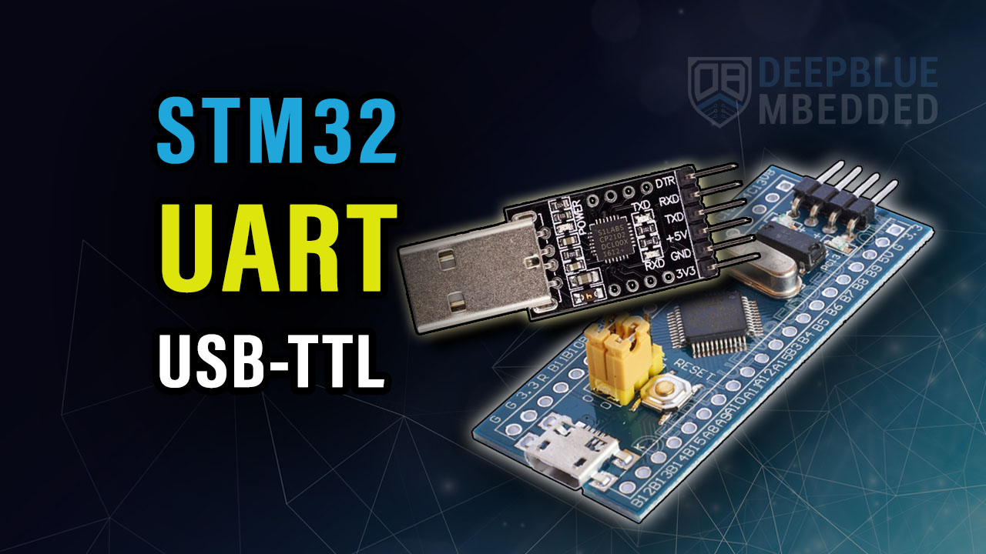
Proposed Solution
TIF Works
Encrypting Sensor Transmissions with STM32 Modules
Problem:
Field sensors broadcast unencrypted over 433 MHz RF mesh
Exposes panda location & sensor data to SDR-based eavesdropping
Recommendation:
Inline encryption module between each sensor and RF transmitter
Encrypts full payload: panda ID, sensor ID, timestamp, environmental data
Prevents both content and behavioral inferences
Solution - Inline Encryption Using STM32 Microcontrollers:
Deploy STM32 microcontrollers on all 4,000 sensors
Supports AES-CCM / ChaCha20-Poly1305 for confidentiality and integrity
Hardware-accelerated, low-power, field-ready
Cost: ~$2.60/module (total: ~$10.4k)

Slide 8
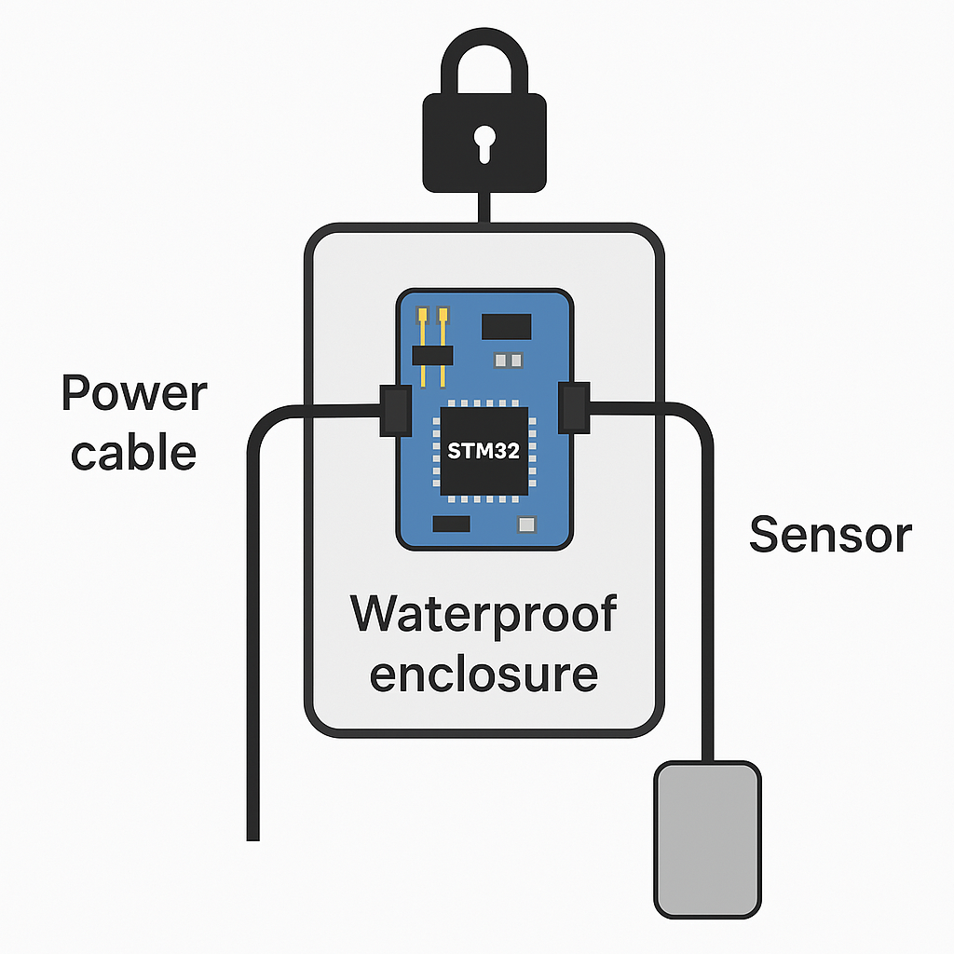
Proposed Solution
TIF Works
Encrypting Sensor Transmissions with STM32 Modules
Implementation and Mitigation:
Preassembled STM32L031K6T6 modules with built-in AES encryption
Housed in IP65 waterproof enclosures with labeled quick-connect plugs
Installs in <15 mins—no config or tech skills required
Mounted with Velcro, zip ties, or adhesive; strain relief via cable glands
Phased rollout by patrol zones; 25 teams = full deployment in weeks
GPS-logged installs with verification tags
Encrypts all outbound data, blocking surveillance
Future updates to obscure timing for traffic analysis resistance

Slide 9

TIF Works
Proposed Solution
Sensor Upload Frequency
Problem:
Encrypted messages still leak when events happen (panda sighting or low battery).
Poachers with SDRs can analyze timing patterns to infer animal movement.
Rangers confirmed that real-time data isn’t necessary—daily updates are sufficient.
Recommendation:
Eliminate real-time transmissions and reduce predictability.
Shift to scheduled, encrypted uploads once per day.
Obscure timing using padding, decoys, and randomized behavior.
Solution 1 - Random Upload Timing with Padded and Dummy Messages:
Upload real sensor data at a random time each day.
Inject dummy encrypted messages throughout the day.
Uniform message size hides real vs fake data.
Strong protection, minimal battery impact, adds scheduling complexity.

Slide 10

Proposed Solution
TIF Works
Sensor Upload Frequency
Solution 2 - Fix Upload Schedule with Padding and Guaranteed Transmission
Transmit once daily at a set time, no matter if data exists.
All messages encrypted, padded to identical size.
Simpler for rangers, predictable over time unless paired with decoys.
Implementation and Mitigation:
Both approaches block poacher traffic analysis via timing obfuscation.
Inline modules handle logic + encryption; no changes to sensors required.
Aligns with ranger workflows and deployment capacity.
Pilot small-scale test to validate battery life, reliability, and usability.
Modular strategy enables scalable deployment without overwhelming staff.

Slide 11

Proposed Solution
TIF Works
Insider Risk
Problem:
High ranger turnover limits accountability and raises leak risk
No 2FA or encryption on local systems
USB ports allow untracked data transfers
No cameras, access logs, or file monitoring
Recommendations:
Enforce 2FA on Kylin OS using FreeOTP or privacyIDEA
Apply role-based access controls and rotate credentials monthly
Add trail cameras and keypad/RFID cabinet locks
Use auditd, Wazuh, or OSSEC for system activity monitoring
Implementation and Mitigation:
Configure 2FA, credential rotation, and USB restrictions
Deploy audit tools for logins, files, and removable media
Install surveillance at server cabinets and entry points
Train rangers on data risks and insider threat prevention

Slide 12
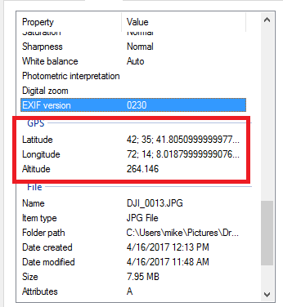
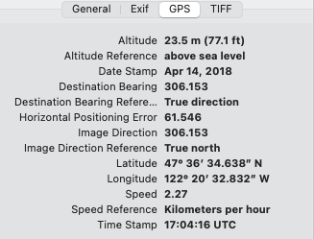
TIF Works
Panda Picture Uploads to WPPL
Problem:
Photos of pandas sent to the WPPL likely include EXIF data, such as geolocation, date, altitude, image direction - which can inadvertently reveal the animals’ whereabouts.
Poachers are likely intercepting this data via the unsecure microwave relay system or by the EXIF data from the photos uploaded to the WPPL public website
Recommendations:
Disable geotagging on all cameras and devices used for capturing panda images
Ensure that all images have their EXIF metadata removed before uploading to the website
Implementation and Mitigation:
Implement a workflow to strip metadata from images immediately upon upload, blur or obfuscate background of images.

Slide 13

TIF Works
Operational Network Vulnerabilities
Problem:
Workstations and server are running outdated operating systems with weak authentication and security measures, leaving them vulnerable to exploits and unauthorized access.
Data transmitted via an unencrypted microwave link is susceptible to interception, potentially exposing sensitive information.
Recommendations:
Modernize endpoints and harden server by upgrading to supported operating systems, implementing multi-factor authentication, and deploying advanced endpoint detection and response solutions.
Secure data transmission by encrypting microwave link.
Implementation and Mitigation:
Implement encryption protocols to create a secure tunnel for data transmission
Establish process for updating endpoints and server, enforce strict access controls, and maintain comprehensive logging.

Slide 14

TIF Works
14.
CONCLUSION
Security Issues addressed:
Encryption of Sensor Transmission to the Base Station
Sensor Upload Frequency
Insider Risk
Panda Picture Uploads to WPPL
Our approach emphasizes the system’s sensitive data - how it behaves, moves, and is accessed.
Integration of these solutions is vital for the system to protect data in the hands of poachers.

